Slide 1
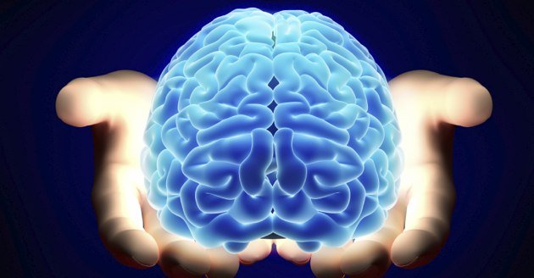
The Science
of
Learning
Kenneth Wesson Educational Consultant: Neuroscience San Jose, CA
kenawesson@aol.com

Slide 2
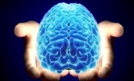
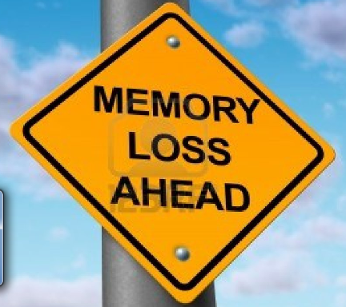
…How Does the Brain Work?
Loosing your memory?
A photographic memory
1. Stress
2. Multitasking
3. Sleep deprivation
4. Nutritional deficiencies
5. Medications: antidepressants, antihistamines, muscle relaxants, tranquilizers, sleeping pills, anti-anxiety and pain medications

Slide 3
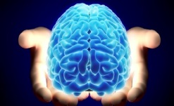
The Science of Learning
What should we know about the latest brain research? Cognitive, emotional, and biological basis of our students learning (vs. not learning/not remembering)
How do we create classroom conditions that advance learning and development?
Interactions, quick writes and quick talks
…a visual and conceptual tour… (a highly visual brain)

Slide 4
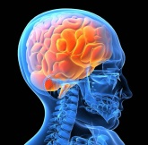
Why a Visual AND a Verbal Tour?
Najjar: Students have 3X better recall of visual information over oral information, but 6X better recall when content is presented using both oral and visual information simultaneously. (↑ movement)
Students who hear information, will remember 10% three days later. By adding a picture(s), they will remembered 65% (Medina, 2008).
(… ↑visual examples)

Slide 5
“How does this
biological brain learn?”
The teacher “covering” the content material and explaining it exceptionally well does NOT necessarily translate into student learning nor is it necessarily the same outcome as what we call “student learning.”

Slide 6
The Phenomenal Human Brain
Our complex neocortex and hands with opposable thumbs have allowed humans to create tools that we have used to manipulate our environment thereby overcoming the restrictions set by our biological heritage.
Spoken language enabled us to represent ideas with distinct utterances (exhale).
The invention of written language allowed us to create distinct shapes as symbols of our ideas.
The evolution of the brain led to our complex neurology, giving rise to technology → explosion of more ideas.

Slide 7
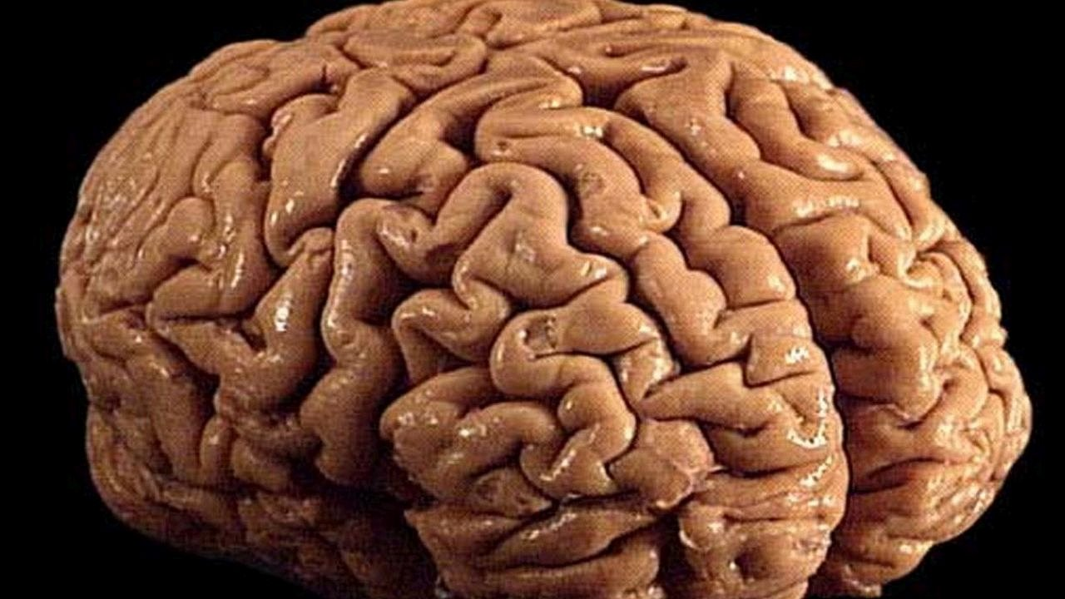
The Function of Every Brain
Experience the World
24/7 we translate our interactions with the world into the chemical language of the brain, and create circuits that represent those experiences

Slide 8
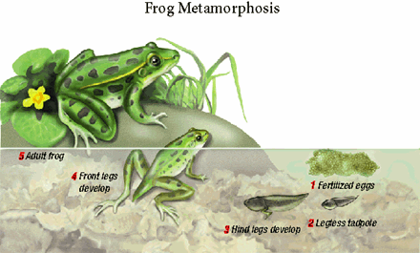
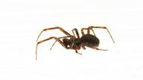
Development is Never Guaranteed
Development is environmentally-dependent.
No land = No frog
“Sensitive period” - no signs of nearby land → tadpoles arrest the process of metamorphosis. When it comes to the brain, as Wadsworth wrote, the child is the father to the man.

Slide 9
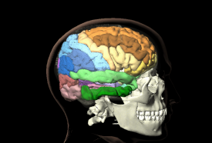
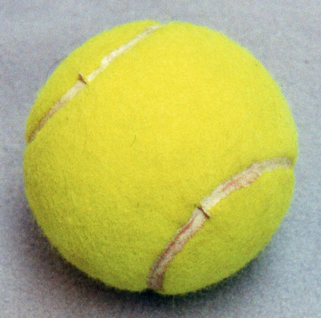
Brain Science: Making Connections
Experience → builds the representative network

Slide 10
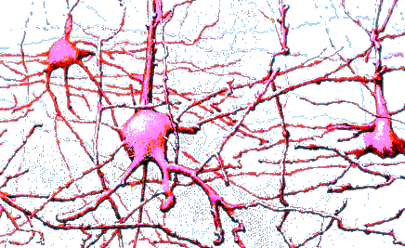
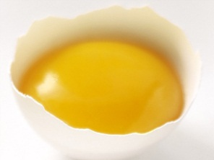
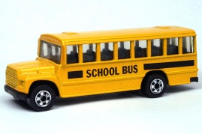
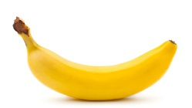
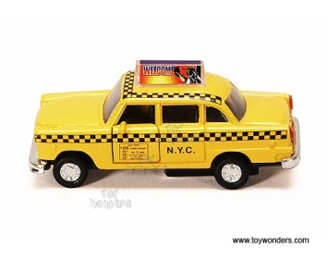
Neurons Making Connections
Egg yolk
ball
Baseball
round
yellow
basketball
coconut
Tennis
Brown
School bus
banana
Taxi
Apple
fruits
persimmon
Orange
pear
Train
pineapple
“Re-purpose” the same cells for participation on countless related brain circuits

Slide 11
“Yellow Tennis Ball”
As the brain learns and adapts to the environment it responds by
1. establishing new synapses
2. sprouting specific dendrites to new target sites (neural connections)
3. producing specific neurotransmitters
4. connecting them to specific cells and elaborate systems (neural pathways)
Alterations in brain wiring become semi-permanent with repetition.

Slide 12
“Yellow Tennis Ball”
Low-level circuits must develop before the complex circuits can develop. They serve as the neuronal foundations for DoK, HOTS, and complexity. (NGSS = “Learning Progressions”)
Learners must use what they already know to construct new understandings.
How People Learn: Brain, Mind, Experience and School
Bransford, J.D., Brown, A.L.& Cooking, R.R. (Eds) 1999, National
Academy Press.

Slide 13
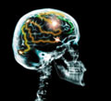
Memory Test
Knitting Sharp
Thread Point
Knife Thimble
Syringe Haystack
Silver Shiny
Pin Injection
Sewing Embroidery
The human brain is learning all of the time and it naturally organizes related information into a Gestalt, not into random lists or separated into individual parts.

Slide 14
What is Learning and Memory?
During “downtime,” (resting, sleeping, day- dreaming, or “zoning out”) the brain is actively “on-line” (1) organizing information gathered from our senses/experiences and, (2) making physical connections to represent those experiences → biological basis of human memory (classroom) .

Slide 15
Crosscutting Concepts
Cognition – from L. base “know together” – to make connections not to “silo” knowledge (or memorize isolated facts)

Slide 16
Maintaining and Strengthening Memory
Bridge Build Extend
10% 80% 10%
Past content New information Preview

Slide 17
20+ Years of Research in Cognitive Science: High Impact Learning Strategies
People learn and remember best through real-world first-hand experiences, not memorization.
Children are born investigators.
Understanding builds over time (knowledge is cumulative and occurs over extended periods of time – “distributed learning”)
We attempt to “make sense” of all incoming stimuli through the senses, visualization, and through formal language (AL).
Science and Engineering require both content knowledge and knowledge of effective practices (SEPs: thinking, knowing and doing - applications)

Slide 18
Thinking: Contemplative Problem Solving (Understanding builds over time)
Contemplative p-s requires “downtime” for thinking: “scholar” – leisure, Greek σχολεῖον “skholeîon” or Latin “skholḗ” = spare time, “leisure” – school is “the time to leisurely practicing problem solving” – rather than doing so impromptu or under pressure (students must be given time to think → make connections).

Slide 19
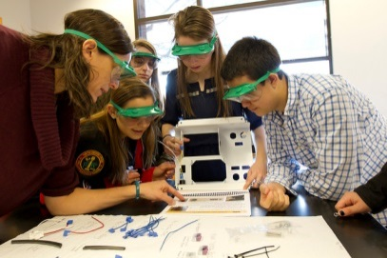
Retention rates
After 24 hours
Verbal processing
Lecture
5%
Reading
10%
Combining the senses
Audiovisual
20%
Verbal and
Visual processing
30%
Demonstration
Discussion group
50%
Learning by doing
75%
Doing
90%
Applied learning (PBL)

Slide 20
Experiences = Cognitive Rehearsals
(→ consolidation)
When playing with objects, learners are simultaneously manipulating/playing with ideas (internal dialogues attach words and meaning to actions – the “mind’s eye”) building the brain’s fundamental circuitry
Exploring and experimenting involve examining relationships, interactions and systems, where learners formulate their own personal “theories” (mental constructs)
Thinking is a cognitive rehearsal for discourse
Discourse is a cognitive rehearsal for writing (phonological loop or “inner voice”)

Slide 21
Cognitive Rehearsals
Playing with objects and ideas, exploring and experimenting, thinking, talking, and writing become cognitive rehearsals (background knowledge) for reading.
Writing and reading clarify one’s thoughts, generate coherent thinking, and cultivate precision in expressing one’s inner thoughts
(→ LT/P memory consolidation)
Discourse and writing become cognitive rehearsals for assessment
Source: Kenneth Wesson (2011). Education for the Real World: six great ideas for parents and teachers.
Brain World, Issue 2, Volume 2.

Slide 22
If they don't learn the way you teach, then
why not teach the way they learn?

Slide 23
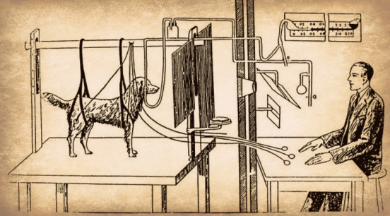
Expanding the Traditional Model of
Thinking and Learning
Does the name “Pavlov” ring a bell?
Stimulus → Response
S → R
Teaching → Learning
Learning is a neurobiological processes occurring inside the brain, just as digestion takes place in the pancreas and the stomach.

Slide 24
The Neural Foundation for Concept Development
“Brain-building” experiences
If I Can… Then I am Able To…
1. Experience it first-hand Discuss it orally
(“Hands-on, minds-on, heart’s-in”
“Wow! experiences)
2. Discuss it orally Understand what others mean, when they talk about it
3. Understand when I discuss it Communicate it in written form
and when and others discuss it
4. Communicate it in written form Read my own writing
5. Do it, see it, discuss it, hear Explain it to others coherently/intelligently
about it and write about it
6. Explain it to others Ready to read other’s writing
7. Understand the writings of Begin reading (the writing of others) within
others on the subject general content area
Excerpted from Memory and the Brain: How Teaching Leads to Learning. Wesson, K. The Independent School, Volume 63, Spring 2002

Slide 25
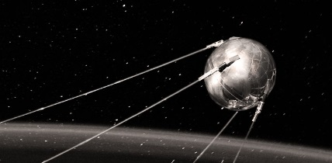
The Science of Learning
Information (1956 >) to
Inquiry (1996 >) to
(2012 >) Investigations
(complexity and interdisciplinarity)
What ?
Why /how does…?
When… ?
Under what
conditions…?
What if…?

Slide 26
Learning is experiencing. Everything else is just information.
---Jean Piaget
Phenomenon-based Science

Slide 27
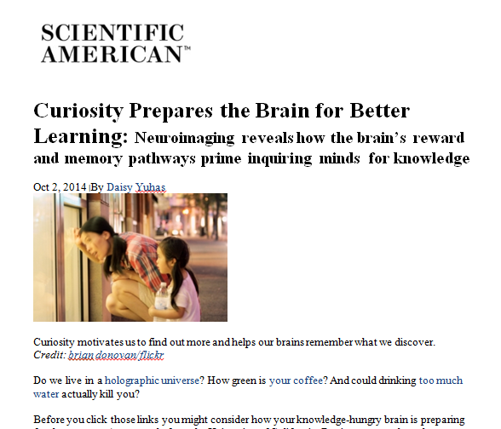
Born investigators

Slide 28
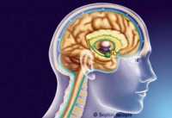
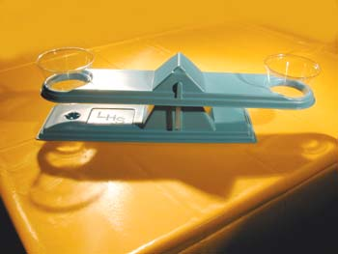
Unleashing the power of inquiry and metacognition
…with liquid?
(“critical competitor”)
A distinction: Brain-derived answers vs. preconceived answers

Slide 29
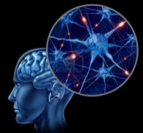
The Science and Engineering Practices =
Thinking and Acting Like a Scientist
Research is a formalized curiosity. It is poking and prying with a purpose.
-- Zora Neale Hurston

Slide 31
There are no “Seven Wonders of the World” in the eyes of a child.
--Walt Streigtiff
There are seven million.

Slide 32
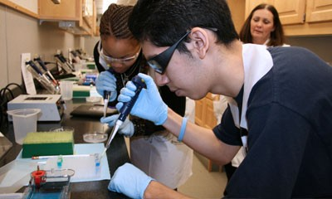
Phenomena-based Science
The best way to engage students in learning is to introduce one or more scientific “FUNomena” where the science intriguing, personal and relevant (the catalysts for further research) – now, students want to investigate (engagement, memorable, transferable)

Slide 33
Unleashing the power of inquiry and metacognition
…with liquid?
(“critical competitor”)
A distinction: Brain-derived answers vs. preconceived answers

Slide 34
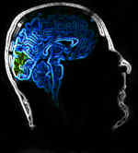
Poking and Prying
at
Light

Slide 35
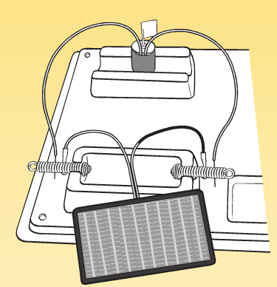
Staying In The Question(s)
What Is Electromagnetism?
The energy in an electric current can produce light, heat, magnetism and/or sound.
Light is a source of energy, as well as a component of electromagnetism.

Slide 36
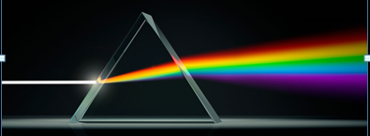
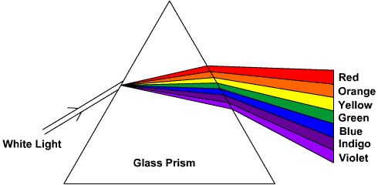
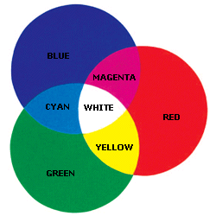
The Electromagnetic Spectrum:
Visible Light and Color

Slide 37
Time and Space/Vision in Space
When the colors green, red, and blue → turned on and off quickly inside the stationary ball, the brain cannot process the colors separately.
However, if we twirl the ball in space, then we can see the separate colors as they pass through a 6 to 12 inch space on the circumference of the circle, as the ball turns off one color and turns on another color.
In doing so, the brain as enough time to process each color independently, but only within their own 6-12 inches of space on the circle as the ball is rotated.

Slide 38
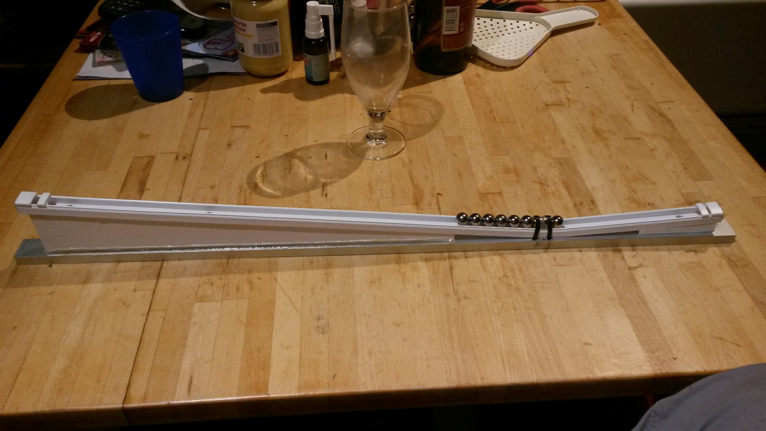

Slide 39
Exploring and Poking at
Gravity

Slide 40
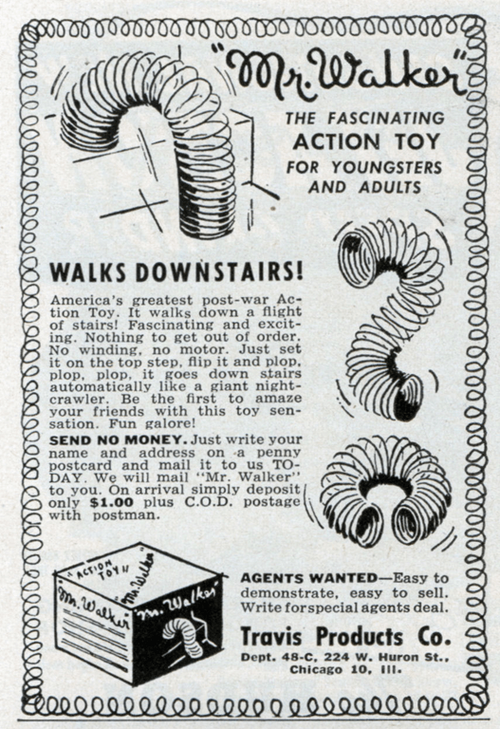
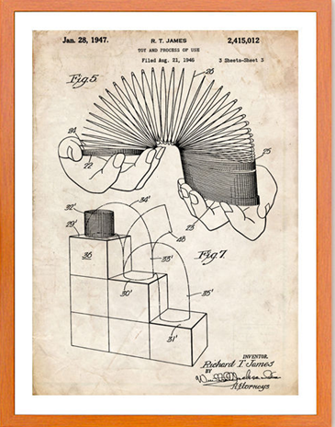
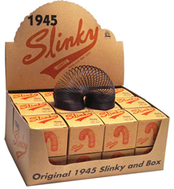
Slinky Toy

Slide 41
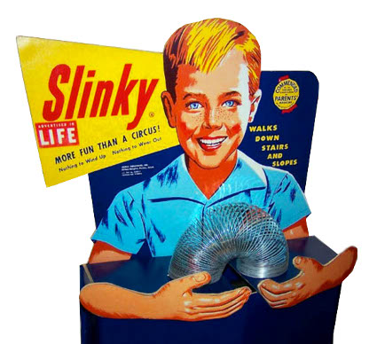
Phenomenon: Slinky Toy
What does a slinky do?
What does a slinky do when it goes downstairs?
Predict how a slinky will fall when it is held by its top end, with the rest of the slinky dangling in air fully extended, and then released into a “free fall”?

Slide 42
Slinky Toy
A. Will the bottom and top fall at the same speed and, thus, land in the same outstretched position?
B. Will the two ends contract (i.e., the top going down, and the bottom rising up) during the free fall, and come together again as it reaches the ground?
C. Will the top end fall first, while the rest of the slinky floats in midair as it contracts, and when the top catches up to the bottom (now fully contracted), only then will the entire slinky will then fall down?
D. Will the bottom fall, continuing to stretch the slinky out more, and when the bottom reaches the ground, the top will contract again with the bottom as it lays on the ground?
E. Would you propose another scenario?

Slide 43
Slinky Toy
While gravity is pulling the bottom end of the slinky down towards the ground, the tension of the spring is pulling the bottom end upwards. The two forces are equal and opposite → suspended briefly in mid-air → and once fully contracted → the force of gravity exceeds the tension (now absent).

Slide 44
Inquiry: Newtonian Physics
Galileo: Two balls dropped from the Tower of Pizza – one heavy and one light. What happened??
Teach “Thinking”
As Bernard Baruch said about curiosity…
“Millions saw the apple fall, but Newton asked ‘Why?’ ”

Slide 45
Ball Rolling Down the Ramp
The position above the Earth’s surface determines an object’s
potential energy.
kinetic energy
which transforms into
(energy of motion)
gravity
when the forces are unbalanced, the ball rolls down the ramp.
pushes
pulls
Ramp pushes on the ball from beneath, while gravity pulls the ball downward along the ramp.

Slide 46
Investigation: Rice on a Ramp
Focus question: Does the amount of rice in a jar affect its rate of descent on an inclined plane (a ramp)?
Part I - Two jars on a ramp:
Jar #1: An empty jar
Jar #2: A jar filled with rice

Slide 47
Rice on a Ramp
(Three possible outcomes). Raise your hand if you think that…
both jars will roll at approximately the same rate of speed. (1) fast, or (2) slowly
each jar will roll at a different rate of speed.
neither jar will roll at all.
Don’t know? Confer with someone
The empty jar will roll faster, because…
The jar filled with rice will roll faster, because…

Slide 48
The Angle of Repose: Graph #2
7
6
5
•
•
4
S e c o n d s
3
2
1
0 (1) 33% (3) 66% (4) 100% (2)
empty
Amount of rice in a jar
full

Slide 49
Rice on a Ramp
Part II: Adding two new jars to the set (now a total of 4 jars):
Jar #3: A jar 1/3 (67%) full of rice
Jar #4: A jar 2/3 (33%) full of rice
.

Slide 50
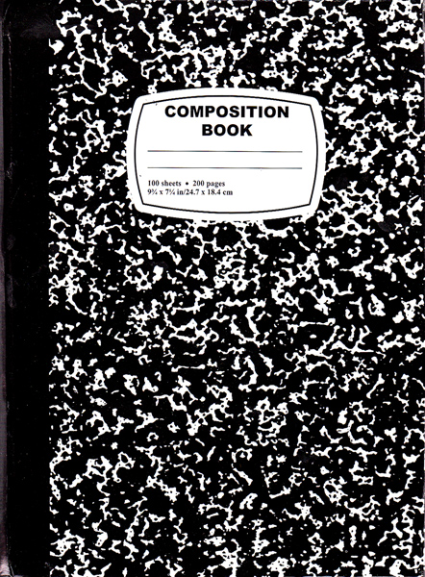
CER: Claims, Evidence, and Reasoning
(CCSS and NGSS)
Making claims based on observations, and using data collected as evidence (reasoning and sense-making: The CCSS refer to this strategy as CER = Claim, Evidence, and Reasoning that are used in constructing explanations)

Slide 51
Rice on a Ramp
Make a prediction about the outcome. Having knowledge about the outcome of zero and 100% full…
Will all 4 jars roll at the same rate of speed? At different speeds? Yes ___ No ___ Explain your answer?
If “no” is your answer, rank order that the four jars will descend from the fastest to the slowest.
Is this statement true? “The less rice there is in a jar, the faster the jar will roll? Yes ___ No ___ Why?
Record your prediction for the jar 2/3 full of rice and the jar that is only 1/3 full of rice will fall on a graph.

Slide 52
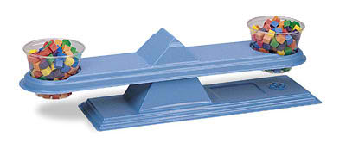
The Angle of Repose:
Jar Only 2/3 full of rice
An avalanche effect the
“free surface” of
the rice
An avalanche effect
on surface of rice
•
…center of gravity is to the right
of the center of balance (decline) pulls jar
down the ramp
“The maximum angle at which an object can rest on an inclined plane without sliding down.”

Slide 53
The Angle of Repose:
the jar 1/3 full of rice
•
When the center of gravity is to
the left of the point of contact, it counter-balances the gravitational pull to the right
The jar sits “reposing the descent”

Slide 54
The Angle of Repose: Graph #2
•
7
6
5
•
•
4
S e c o n d s
3
2
1
•
0 (1) 33% (3) 66% (4) 100% (2)
empty
Amount of rice in a jar
full
“data-driven”?

Slide 55
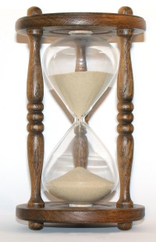
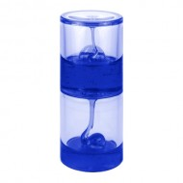
Fluid Dynamics
What do you predict would occur if the jar was 1/3 full with honey?
Gravity would cause the honey to move as it seeks a resting point. However, it will move ever so slowly down the ramp instead.
Leave the room → come back 30 minutes later → the jar will have moved (mysteriously? No, just plain fluid dynamics - physics).
Viscous fluid clock

Slide 56
Playing with Water:
Fluid Dynamics

Slide 57
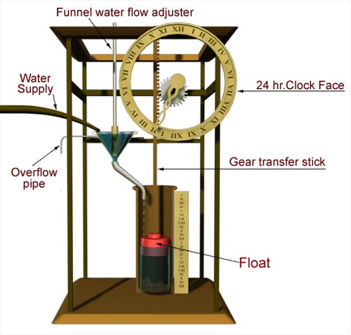
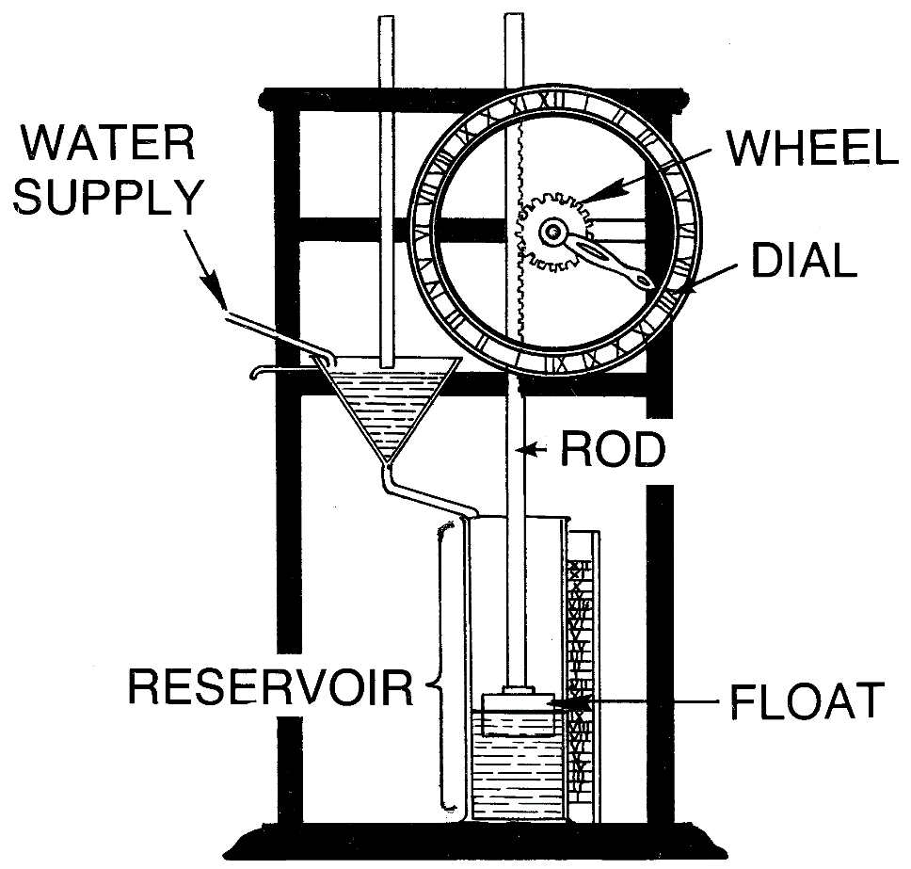
Playing with Water:
Fluid Dynamics

Slide 58
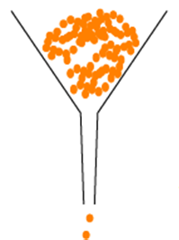
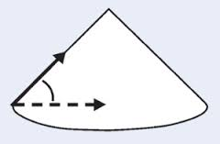
Demonstrating the
Angle of Repose for Rice
Pour rice into an empty half gallon (milk) carton.
Pour the half gallon of rice through a funnel.
Observe the rice forming a conical (cone-shaped) pile.
The rice pile continues to get higher, but its slope will remain exactly the same.

Slide 59
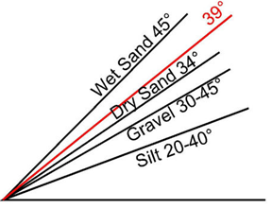
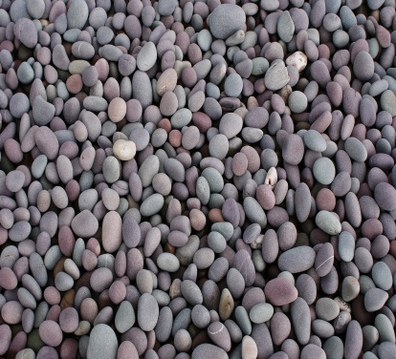
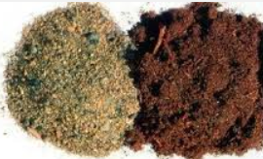
The Angle of Repose:
Pebbles, Sand and Silt
Silt and powders cannot be piled as steeply as gravel.
Gravel pebbles cannot be piled as steeply as smooth dry sand pebbles.
Dry sand cannot be piled as steeply as wet sand (sand castles are possible when small amounts of water are able to bridge the gaps between sand particles holding them together)
gravity-dependent
A material with a low angle of repose (silt) will form a flatter pile than another material with a high angle of repose (pebbles).

Slide 60
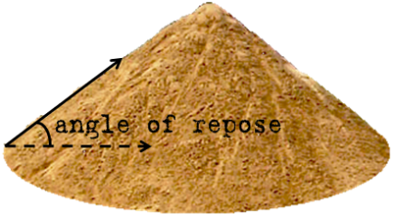
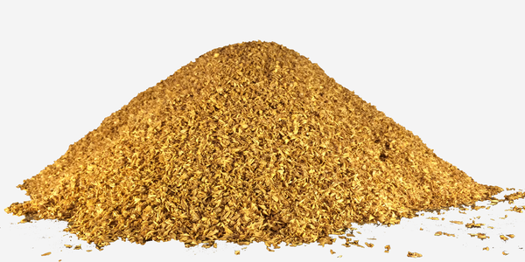
Pebbles, Sand and Silt: The Angle of Repose
If you were to pour several buckets of sand into a pile…
A conical shaped pile
The angle of repose is the steepest angle of descent relative to the horizontal plane to which the material can be piled remaining stable (without sliding down any further.) There is a limit as to how steep a sand pile can be before the sand begins to slide down the sides. (Granular physics)

Slide 61
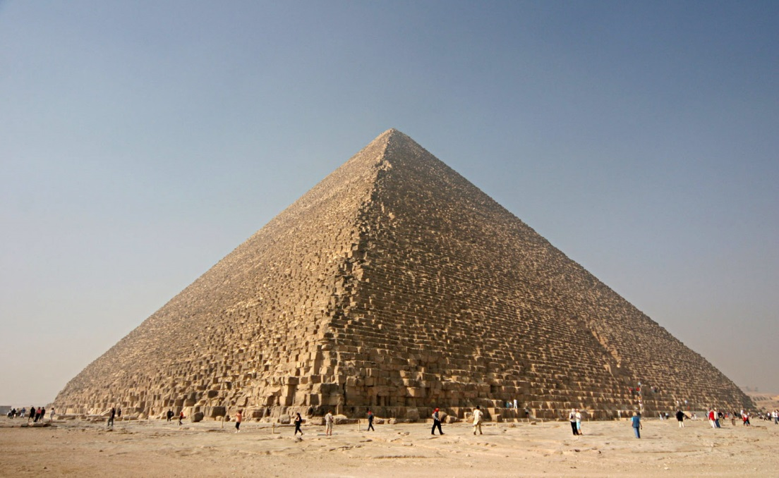
A Similar Angle of Repose
A conical shaped pile
Egyptian Pyramid

Slide 62
Change the Narrative
Our best efforts in teaching requires a shift from…
“What am I supposed to teach?”
to
“How do my students learn?”

Slide 63
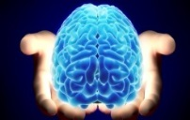
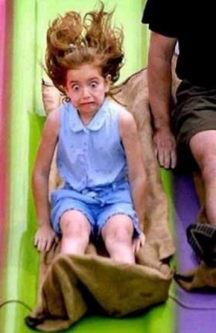
PERC³S
There are five BC elements that the human brain seeks while processing incoming stimuli for personal “meaning,” which makes the information “memorable” and worth remembering.
Patterns (derivative of visual experience)
Emotions
Relevance
Context, Content, and Cognitively-appropriate
Sense-making → Stories (narrative)
Patterns, emotions, relevance, context, content and sense-making are critical factors in driving (1) attention, (2) motivation, (3) learning, (4) memory formation, and (5) recall. Collectively, these 5 factors are the primary criteria for transfer into long-term memory storage.

Slide 65
Auditoty Patterns → Quick Answers
Mary’s mother had only four children: April, May, June and …?
The pattern-seeking human brain always searches for patterns → you responsively answer “July” which is the next month in a deeply ingrained sequential pattern, but does not answer the question correctly. The correct answer is Mary - Mary’s mother is where the question actually begins.

Slide 66
Patterns: Understanding/Remembering Medical Terms
All medical terms must make sense.
Sciencemaster.com
Verbs → Nouns ↓ | -algia (pain) | -centesis (puncture) | -ectomy (removal) | -tomy (incision) | -itis (inflamation) | -plasty (surgical repair) | -megaly (enlargement) | -sclerosis (hardening)
Angio- (vessel) | -- | angiocen-tesis |  | angiotomy | angitis | angioplasty | angiomegaly | angiosclerosis
Craino- (skull) | -- | craniocen-tesis | (hemispher- rectomy) | craniotomy | -- | cranioplasty | -- | craniosclerosis
Cardio- (heart) | cardialgia | cardiocen-tesis | -- | cardiotomy | carditis | cardioplasty | megalocardia | cardiosclerosis
Derma- (skin) | -- | dermacen- tesis | -- | (incision) | dermatitis | dermaplasty | -- | sclerderma
Gastro- (stomach) | gastria | gastrocen-tesis | gastrectomy | -- | gastritis | gastroplasty | gastromegaly | --
Neuro- (nerve) | neuralgia | -- | -- | -- | neuritis | -- | -- | multiple sclerosis
Osteo- (bone) | ostealgia | osteocen-tesis | -- | osteotomy | osteoarthritis | ostoplasty | osteomegaly | osteosclerosis

Slide 67
The Evolution of
Human Reading
We were never born to read.
We were born to learn (by patterns).

Slide 68
“The Perfect Storm” for Teaching Decoding
In English:
26 letters of the English alphabet
44 phonemic sounds (spelled 400+ diff. ways)
220 commonly used sight words
600,000 words
6 written syllable spelling patterns

Slide 69
Reverse Direction Decoding
Dactyloscopy:
The practice of using fingerprints for personal identification
dak-tu-los'ku-pē
(-py) = pē
(-copy) = ku-pē
(-loscopy) = los'ku-pē
(-tyloscopy) = tu-los'ku-pē
dactyloscopy = dak-tu-los'ku-pē

Slide 70
Colorectal
adenocarcinoma
diverticulitis
australopithecus
microscopy
deoxyribonucleic
phenothiazine

Slide 71
-
Co-lo-rec-tal
A-de-no-car-ci-no-ma
Di-ver-tic-u-li-tis
Aus-tra-lo-pith-e-cus
Mi-cros-co-py
De-ox-y-ri-bo-nu-cle-ic
Phe-no-thi-a-zine
Diatomaceous
= Di-a-tom-a-ceous

Slide 72
“In fact, the automaticity with which skillful readers recognize words is the key to the whole system…The reader’s attention can be focused on the meaning and message of a text only to the extent that it’s free from fussing with the words and letters.”
--Marilyn Adams

Slide 73
Science just got easier!

Slide 74
Creativity: A Defining Characteristic
of Homo Sapiens
Human beings are the only animal on the planet that looks for problems and for problems to solve. In the late 1800s to the mid-20th century, highly creative minds were needed to solve contemporary challenges. If a problem that was frequently encountered, someone visualized, designed and produced a tool to solve that problem.

Slide 75
How well do we teach creativity, visualization, and innovative thinking?
The Power of Visualization
Seeing With the Mind’s Eye

Slide 77
Visual Thinking: Which Room?
A murderer is condemned to death. He has to choose between three rooms. The first is full of raging fires, the second room is darkened, but full of assassins with loaded guns, and the third is full of lions that haven't eaten in 3 years. You are his advisor. Which room would you say is safest for him?

Slide 78
Answer?
The raging fires
The assassins
The lions
The third room, after three years, the lions should have starved to death.

Slide 79
The Power of Visualization
and
Your Reaction Time

Slide 80
The Power of Visualization
A = Awesome
B = Brilliant

Slide 81
Using your Reflexes
(Each takes 0.05 – 0.1 sec.)
Eyes → sight (2) visual cortex – vision → (3) association cortex - meaning → (4) frontal lobes – plan of action → (5) PfC – prepares response → (6) motor cortex – takes an action
6
3
5
2
4

Slide 82
Reflexes: In the Mind
(Each takes 0.05 – 0.1 sec.)
PfC – prepares response (2) Ears → hearing → (3) motor cortex – takes an action
3
1
2

Slide 83
Reflexes: Visualization
(Each takes 0.05 – 0.1 sec.)
Eyes → sight (2) visual cortex – vision → (3) association cortex - meaning → (4) frontal lobes – plan of action → (5) PfC – prepares response → (6) motor cortex – takes an action
6
3
5
2
4

Slide 84
Students who lack ability . . .
to create visual images when reading, often experience comprehension difficulties.
They cannot describe the pictures in their minds as they read.
Learners who were instructed to create mental images of events…learned two to three times as much as learners who read aloud the sentences repeatedly. (Anderson, 1971)

Slide 85
The illiterates of the future are not those who cannot read or write, but those who cannot learn, un-learn, and re-learn. --Alvin Toffler

Slide 86
How do we know when our classroom, school or school district has embraced and implemented the Next Generation Science Standards?
What is the teacher doing differently?
What are the students doing differently?

Slide 87
The NGSS teacher is…
taking the time for 3-D planning and preparation (SEPs, CCCs, and DCIs) and being attentive to lesson sequence and learning progressions)
engaging students with a phenomenon
talking less and “guiding” more
preparing to address preconceptions and misconceptions (and modifying instruction accordingly - “responsive teaching”)
T’ how to support one’s arguments with evidence
checking for understanding rather than for correct answers

Slide 88
Students are…
engaged in an active first-person (hands-on) investigations of a developmentally-appropriate scientific phenomenon. (“The person doing the work is doing the learning.” -- Doyle)
engaged in scientific practices that lead to making sense of the phenomenon under investigation
engaged in engineering practices (developing physical and mental models – hypothetical constructs)
involved in deep student-to-student discourse, dialogue, idea-sharing, debate, and reflection
developing and expanding one’s vocabulary in the context of doing
asking questions of one another to make sense of scientific phenomena

Slide 89
The Science of Learning
Neuroplasticity: the ability of the brain to change cellular, structural and functional properties as a result of experience. Researchers have shown that early brain connections are not hard-wired (fixed) and can be modified by experience – they are malleable or
“plastic.”
One of the most transformative discoveries/take-home messages
All brains can change,
all brains do change,
brains were designed to change.
Years of keyboarding →handwriting?

Slide 90
Students may forget what you said, but they will never forget how you made them feel. -- Carl W. Buechner

Slide 91
Healthy Brains
Our School Mission is Bigger than “Content”
One of the most important things a teacher can do is to send a student home in the afternoon liking himself just a little bit better than when he came in the morning.
– – Ernest Melby
Most powerful question…
“Guess what I did today? It was the best day ever!”

Slide 92
Healthy Brain Development
…only species on the planet that can
create environments and learning events
that determine how and if the young brains
around us physically grow, develop and thrive.

Slide 94
Contact Information:
Kenneth Wesson
National Science Consultant
(408) 323-1498 (office)
(408) 826-9595 (cell) San Jose, CA
Ken.wesson@schoolspecialty.com
sciencemaster.com

